Slide 1
Diabetes Prediction using machine learning
Presented by
Saikuslu Gullapalli,
Sridhar Seepana, 700724732
Naga Chetan Kumar Reddy , 700743408
Yalavarthi rohith, 700742323

Slide 2
Roles , Responsibilities and Contribution
Project proposal and dataset creation: This step entails problem description, the creation of specific objectives and results, and the gathering of the dataset utilising references. This work is completed by Sridhar Seepana, 700742973.
Data analysis and null value management: Data analysis and null value management: This phase involves importing the dataset, listing the necessary Python modules, looking for null values, and filling them with the mean value. This task is completed by Saikuslu Gullapalli, 700743291.
Model and Code Implementation: Support vector Machine is the algorithm used which is effective in high-dimensional case and implemented the code in python flask. This task is completed Naga Chetan Kumar, 700743408.
Exploratory data analysis: Here, all of the dataset's columns are carefully examined, graphs are produced to determine the characteristics for modeling, and other correlation charts are produced. This task is completed by Rohith Yalavarthi, 700745581.
Contributions:
Naga Chetan Kumar Reddy, 700740478 25%
Sridhar Seepana, 700724732 25%
Yalavarthi rohith, 700742323 25%
Saikuslu Gullapalli, 700743291 25%

Slide 3
Motivation:
The primary motivation behind this project is to provide a tool that can accurately predict the likelihood of an individual developing diabetes. Early prediction can help individuals take preventive measures, such as lifestyle changes or medical treatment, to reduce the risk of developing the disease or manage the symptoms.
Significance:
The significance of this project lies in its potential to improve the quality of life for individuals at risk of developing diabetes. Accurate prediction of the onset of diabetes can help individuals take proactive steps to prevent or manage the disease and prevent complications.
Objectives:
The primary objective of this project is to develop a machine learning model that can predict the onset of diabetes with high accuracy. Other objectives include identifying the most significant risk factors for diabetes and developing a user-friendly interface for the prediction model.

Slide 4
Features:
Data collection and preprocessing: This involves collecting relevant data on risk factors for diabetes and preprocessing it to prepare it for machine learning.
Feature selection: Identifying the most significant risk factors for diabetes and selecting them as input variables for the machine learning model.
Model development: Developing a machine learning model using a suitable algorithm, such as logistic regression or a decision tree, to predict the onset of diabetes.
Model evaluation: Evaluating the performance of the machine learning model using metrics such as accuracy, precision, recall, and F1 score.
User interface: Developing a user-friendly interface for the prediction model to make it accessible and easy to use for individuals at risk of developing diabetes.

Slide 5
Related Work
S. Perveen, M. Shahbaz, K. Keshavjee and A. Guergachi [1] in their paper demonstrated the supremacy of Naïve Bayes with K-medoids under-sampling technique as compared to random under-sampling, over-sampling and no sampling.
K. L. Priya, M. S. Charan Reddy Kypa, M. M. Sudhan Reddy and G. R. Mohan Reddy [2] In their study, an analysis of diabetes forecasting is done to increase precision using AI grouping calculation. Compared to other classifiers, the Naive Bayes classifier achieves higher accuracy.
P. Sonar and K. JayaMalini [3] in their paper demonstrated that SVM is excellent when we are unsure of the data. SVM method performs well even with unstructured and semi-structured data like text, pictures, and trees. The SVM algorithm's flaw is that multiple crucial parameters must be set appropriately in order to get the best classification results for any given situation.
Aishwarya Mujumdara, Dr. Vaidehi Vb [4] In their study applied various machine learning algorithms on the dataset and the classification has been done using various algorithms of which Logistic Regression gives highest accuracy.

Slide 6
Problem Statement
One of the most fatal diseases in the world is diabetes. Inspite of this, Most of the people facing different types of problems like blindness, chronic kidney disease, hearing, cardiac failure, etc. In this case, the patient must visit a diagnostic facility to get their reports after consultation.
With the advanced Machine Learning techniques, we now are planning a tool to have the flexibility to look for a solution to the current problem rather investing time and money.

Slide 7
Proposed Solution
In this study, different machine learning algorithms are applied to the dataset, and classification is done using different techniques, with the maximum accuracy being achieved by Logistic Regression.
With the dataset used for the experiment, it is obvious that the model enhances diabetes prediction precision and accuracy.
This research can be expanded further to determine the likelihood that non-diabetics will get diabetes during the following few years.

Slide 8
Results/Simulations
Loading the libraries
Data Loading
Data preprocessing
Label Encoding
SVM
Random forest
Ada boost
Gradient Boosting Classifier
Final Confusion Matrix

Slide 9
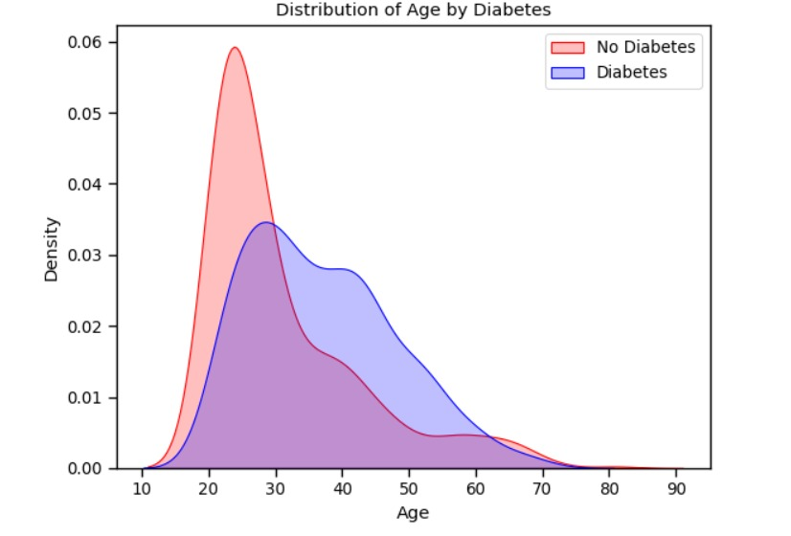
Distribution of age by Diabetes

Slide 10
KNN Classifier and SVM Classifier
KNN accuracy: 0.6277056277056277
SVM accuracy is : 0.6406926406926406

Slide 11
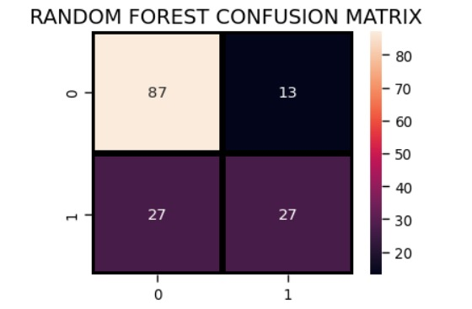
Random Forest Classifier
Random Forest accuracy is : 0.7402597402597403

Slide 12
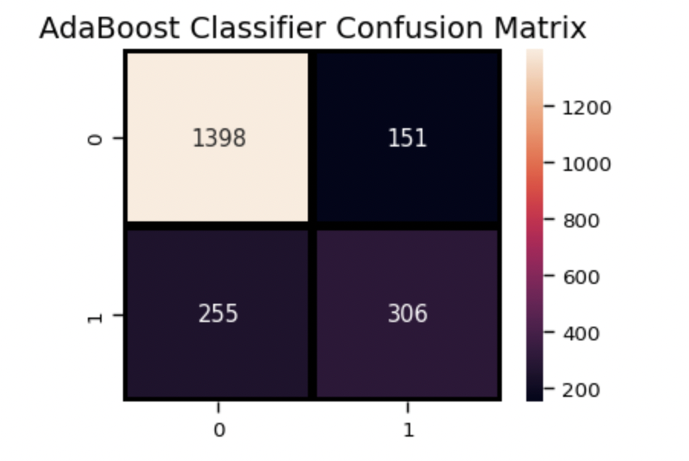
AdaBoost Classifier
AdaBoost Classifier accuracy : 0.7142857142857143

Slide 13
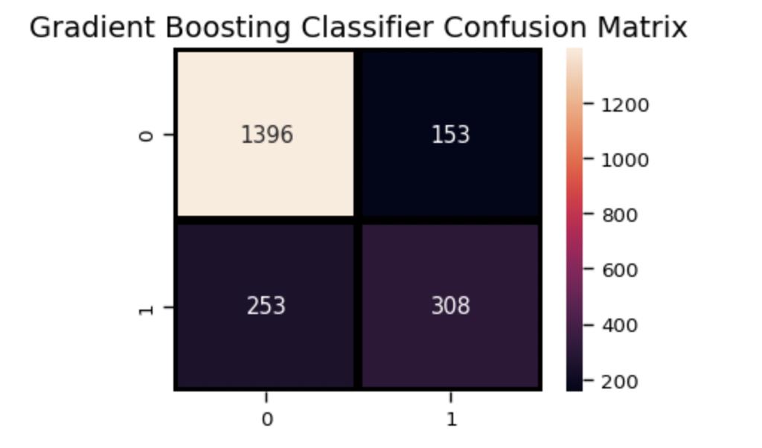
Gradient Boosting Classifier
Gradient Boosting Classifier : 0.7402597402597403

Slide 14
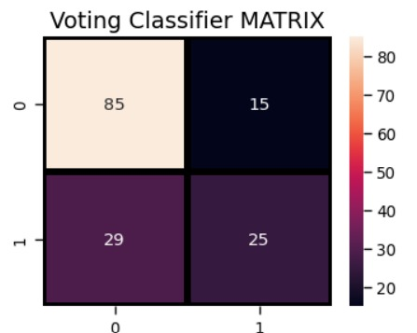
Voting Classifier
Voting Classifier Accuracy Score : 0.7402597402597403
Notes:
It is evident from the confusion matrix that there are total 1400+149=1549 actual non-churn values and the algorithm predicts 1400 of them as non churn and 149 of them as churn. While there are 237+324=561 actual churn values and the algorithm predicts 237 of them as non churn values and 324 of them as churn values.

Slide 15
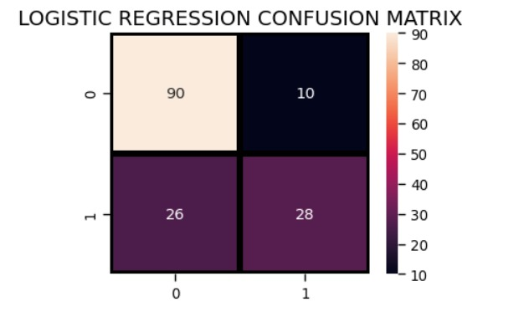
Logistic Regression
Final Accuracy Score: 0.757575757575757576
It is evident from the confusion matrix that there are total 90=10=100 actual non diabetic count and the algorithm predicts 90 of them as non diabetic and 10 of them as diabetic. While there are 26+28=56 actual diabetic count and the algorithm predicts 26 of them as non diabetic count and 28 of them as diabetic predicted count.

Slide 16
References
S. Perveen, M. Shahbaz, K. Keshavjee and A. Guergachi, "Metabolic Syndrome and Development of Diabetes Mellitus: Predictive Modeling Based on Machine Learning Techniques," in IEEE Access, vol. 7, pp. 1365-1375, 2019
K. L. Priya, M. S. Charan Reddy Kypa, M. M. Sudhan Reddy and G. R. Mohan Reddy, "A Novel Approach to Predict Diabetes by Using Naive Bayes Classifier," 2020 4th International Conference on Trends in Electronics and Informatics (ICOEI)(48184), Tirunelveli, India, 2020, pp. 603-607.
P. Sonar and K. JayaMalini, "Diabetes Prediction Using Different Machine Learning Approaches," 2019 3rd International Conference on Computing Methodologies and Communication (ICCMC), Erode, India, 2019, pp. 367-371.
Aishwarya Mujumdara, Dr. Vaidehi Vb,” Diabetes Prediction using Machine Learning Algorithms”, INTERNATIONAL CONFERENCE ON RECENT TRENDS IN ADVANCED COMPUTING 2019, ICRTAC 2019.
Mohan, N., & Jain, V. (2020). Performance Analysis of Support Vector Machine in Diabetes Prediction. 2020 4th International Conference on Electronics, Communication and Aerospace Technology (ICECA). https://doi:10.1109/iceca49313.2020.9297411

